Slide 1

DS6373 Timeseries Term Project
Josh Mitchell
Gowtham Katta

Slide 2
Agenda
Dataset Overview
Exploratory Data Analysis
Models
ARMA / ARIMA
Models
VAR / MLP / Ensemble
Summary

Slide 3
Dataset Overview
Dataset Variables:
Date - In format: yyyy-mm-dd
High - Highest price reached in the day in USD
Low - Lowest price reached in the day in USD
Open - Price of the stock at market open in USD
Close - Price of the stock at market close in USD
Volume - Number of shares traded
Adj.Close - Closing price adjusted for splits and dividend distributions
PerChange - Percentage change in stock price between Open and Close.
PerSwing - Percentage change in stock price between High and Low.
Name - Stock ticker name (29 different stocks)
The dataset consists of stock data between 2006-01-03 and 2022-11-14.
29 different stocks were chosen (4247 per stock).
123163 observations
9 explanatory variables
Response: Close

Slide 4
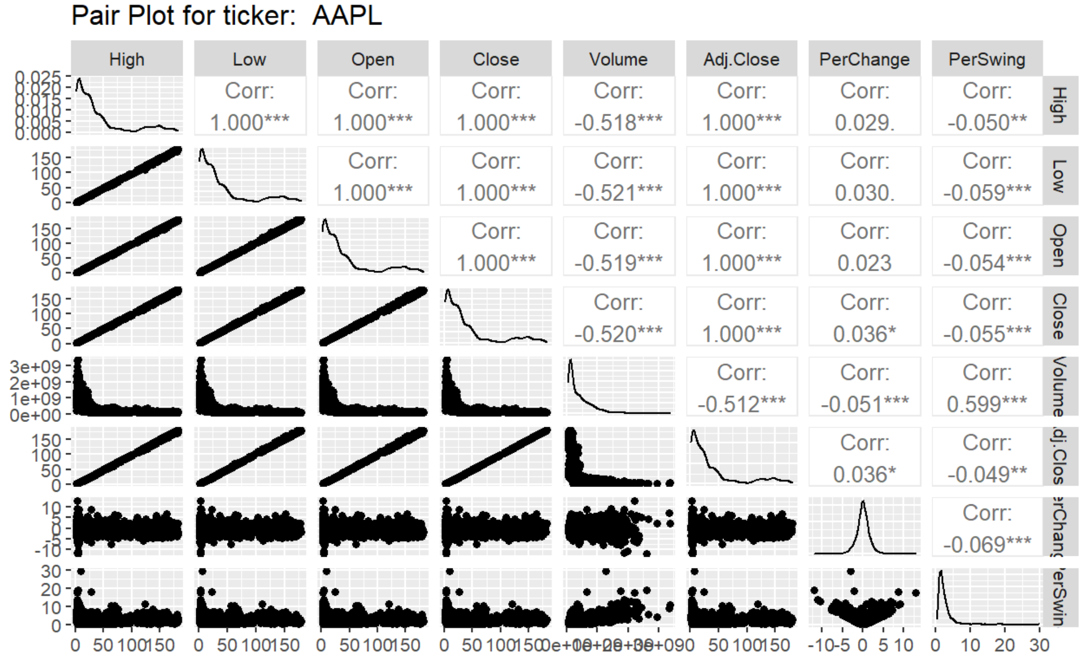
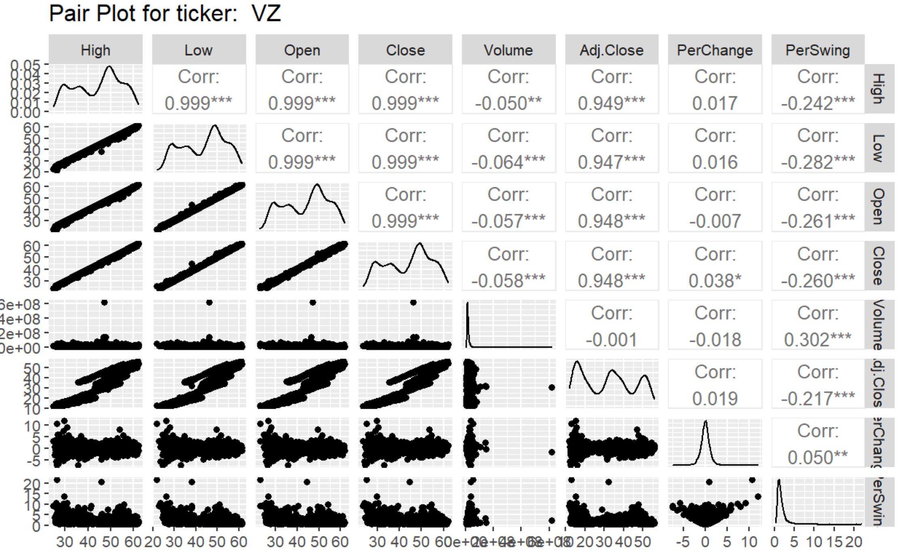
EDA
Investigated pair plots across all levels of the Name factor showed consistent correlation between High, Low, Open, Close, and Adj.Close.
Sufficient differences existed between Name factor levels to force us to focus on a single stock (AAPL).

Slide 5
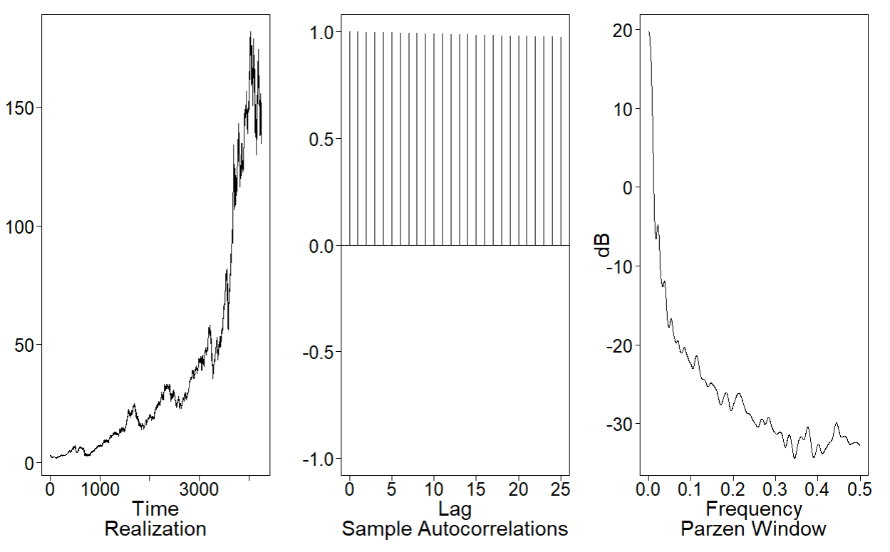
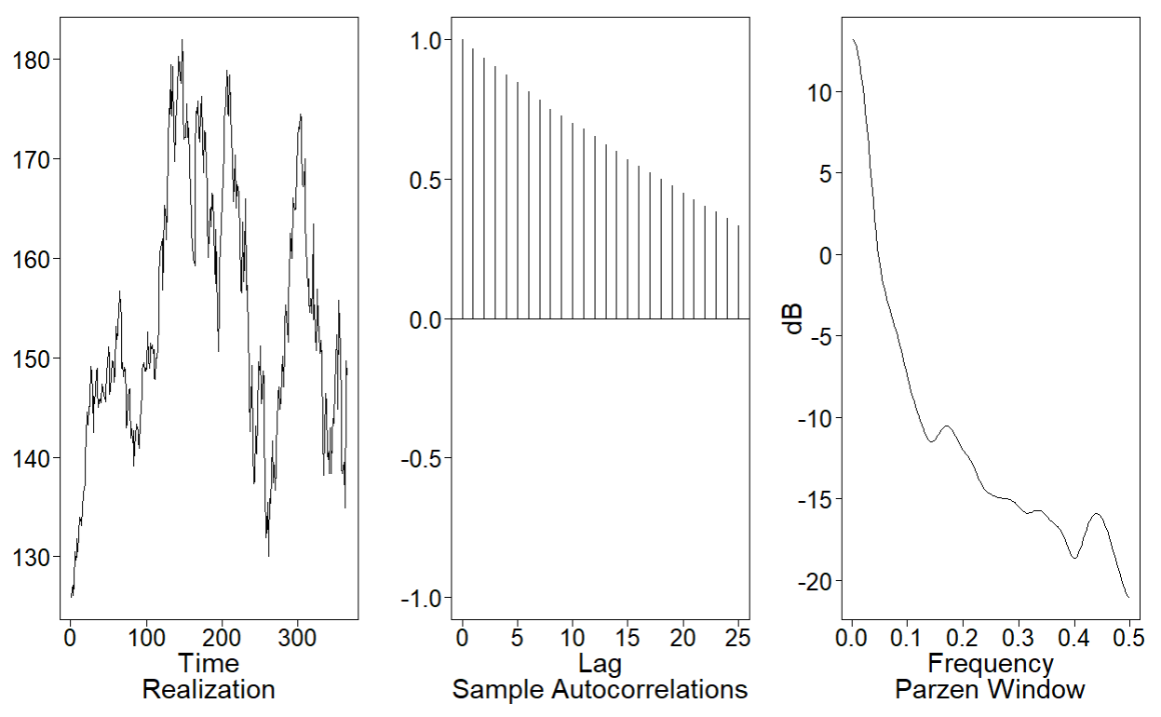
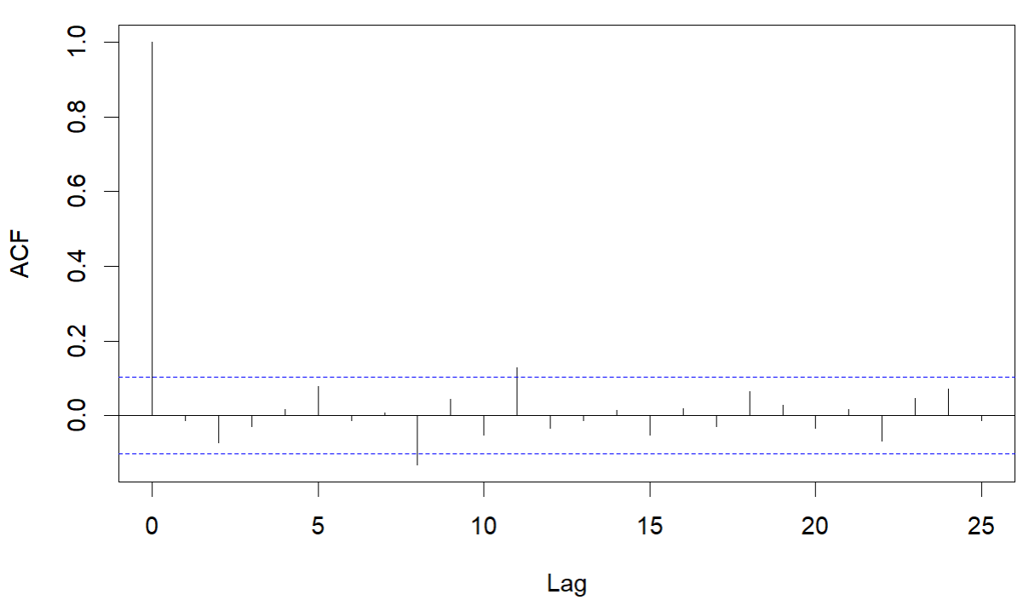
EDA – AAPL
AAPL ACF and Realization Behavior
Non-cyclic wandering behavior with strong correlation between data values that are near each other in time
Non-stationary
AAPL Full Time Range
AAPL 365 Day Restricted
AAPL ACF (1-B) Removed

Slide 6
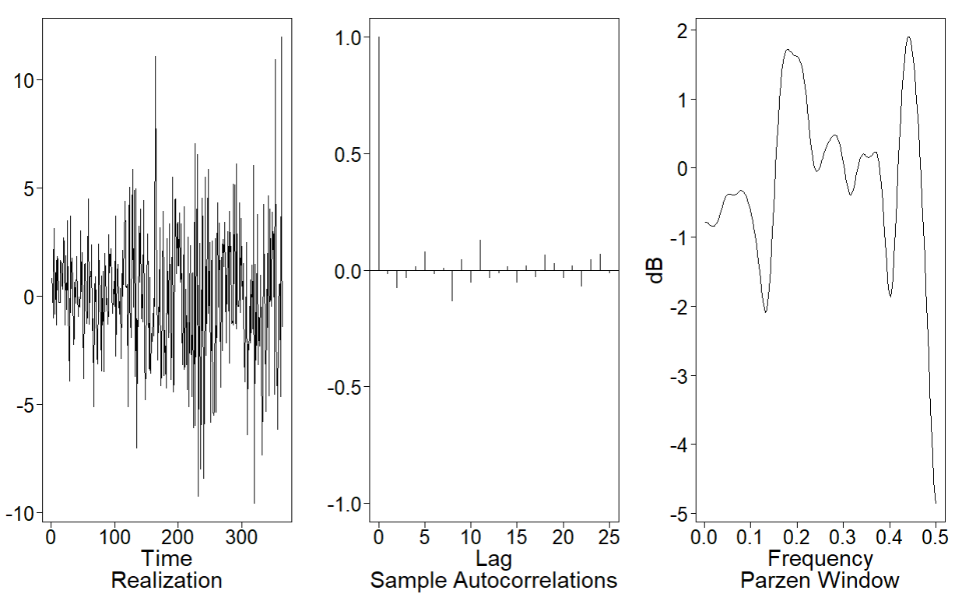
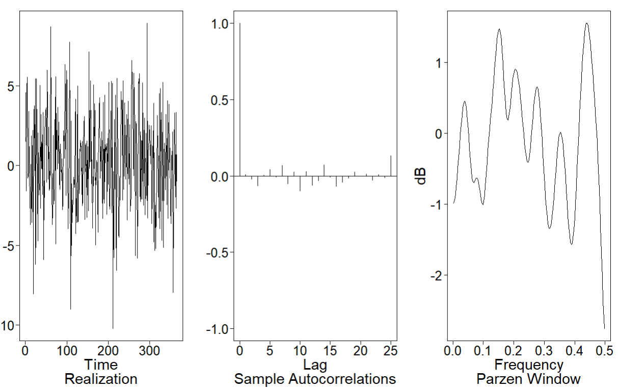
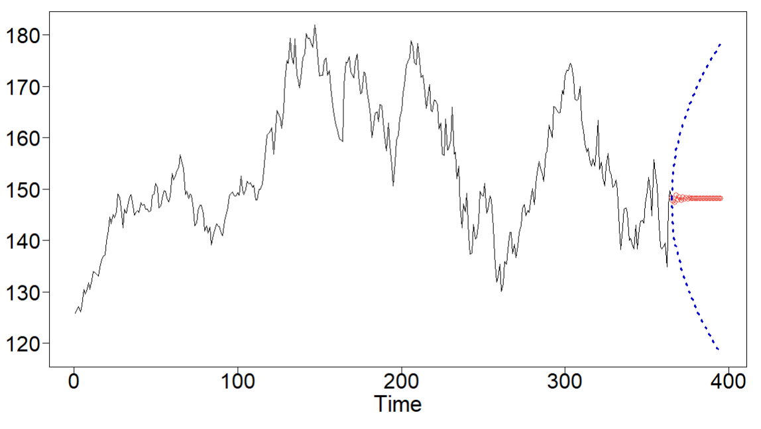
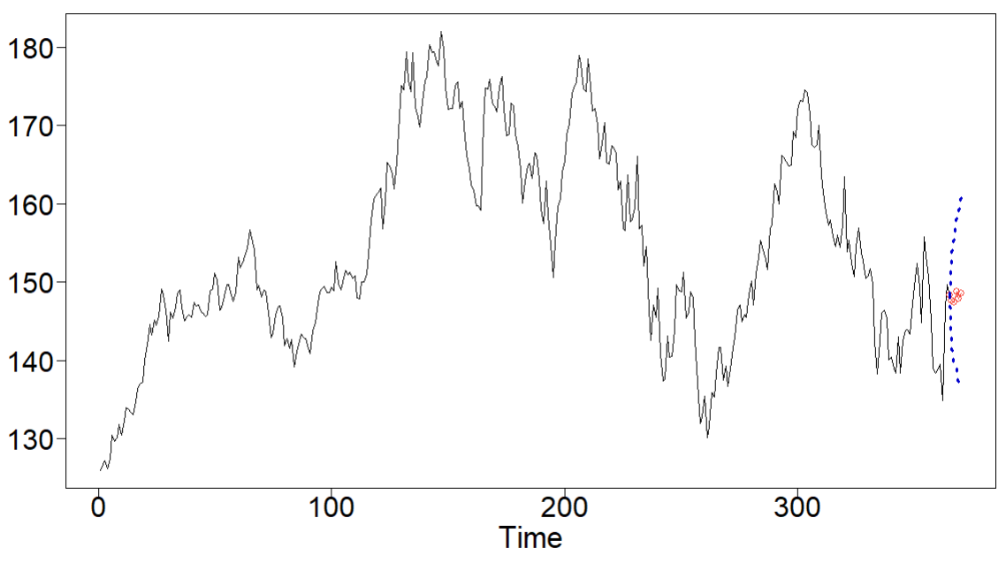
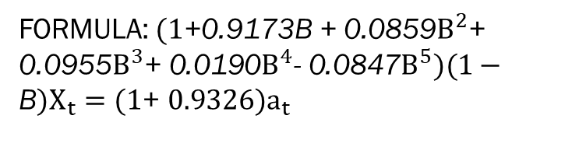
Model: ARIMA(5,1,1)
FORMULA: $(1\text{+}\text{0.9173}\text{B}\text{ + 0.0859}B^{2}\text{+ }\text{0.0955}B^{3}\text{+ }\text{0.0190}B^{4}\text{− }\text{0.0847}B^{5})(1−\text{B})X_{t}={(1\text{+ }0.9326)a}_{t}$
AIC:
2.213120
RMSE:
5-day rolling window 4.455
30-day rolling window 10.184
ASE:
5-day 57.6851
30-day 33.13971
Original
Ljung-Box test
Phi: -0.9173, -0.0859, -0.0955, -0.0190, 0.0847
Theta: -0.9326
White noise variance: 8.799178
Generated
30-day forecast
5-day forecast

Slide 7
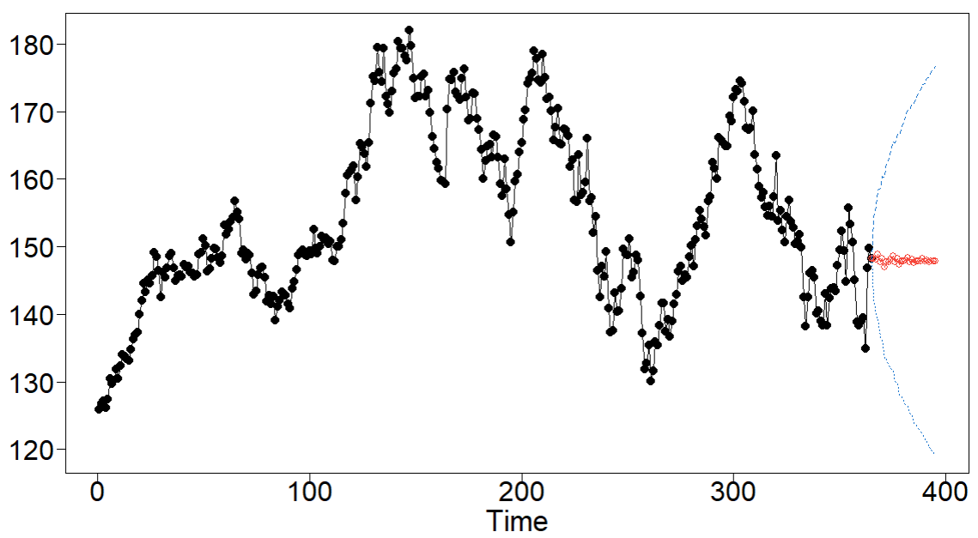
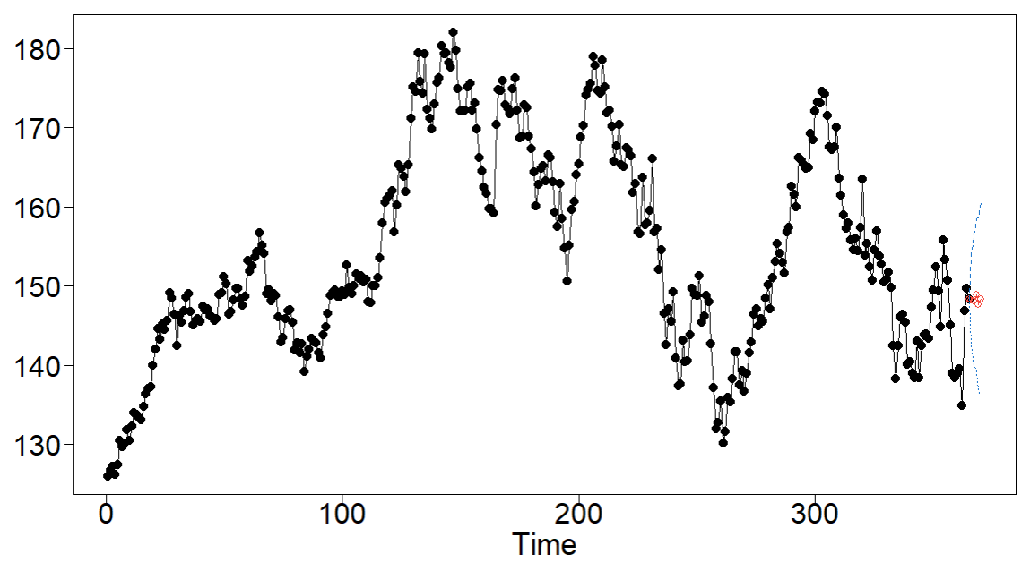
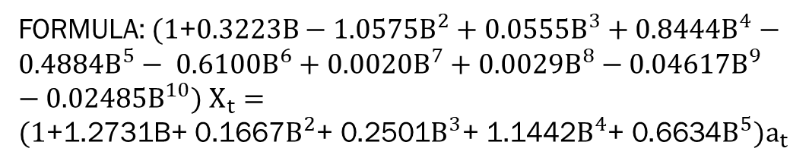
Model: ARMA(10,5)
FORMULA: $(1\text{+}0.3223B−$ 1.0575$B^{2}$ + 0.0555$B^{3}$ + 0.8444$B^{4}$ $−$ 0.4884$B^{5}$ $−$ 0.6100$B^{6}$ + 0.0020$B^{7}$ + 0.0029$B^{8}$ $−$0.04617$B^{9}$ $−$0.02485$B^{10}$)$X_{t}={(1\text{+}\text{1.273}\text{1}\text{B}\text{+ 0.1667}B^{2}\text{+ }\text{0.2501}B^{3}\text{+}\text{ 1.144}\text{2}B^{4}\text{+}\text{ 0.6634}B^{5})a}_{t}$
AIC:
0.3617634
RMSE:
5-day rolling window 4.404
30-day rolling window 10.142
ASE:
5-day 53.289
30-day 29.171
Cochrane-Orcutt test
Phi: -0.322309522, 1.057487180, -0.055477750, -0.844429717, 0.488404731, 0.610026678, -0.002045086, -0.002878810, 0.046165984, 0.024858653
Theta: -1.2731792, -0.1666368, -0.2501280, -1.1441992, -0.6634130
White noise variance: 1.425081
30-day forecast
5-day forecast

Slide 8
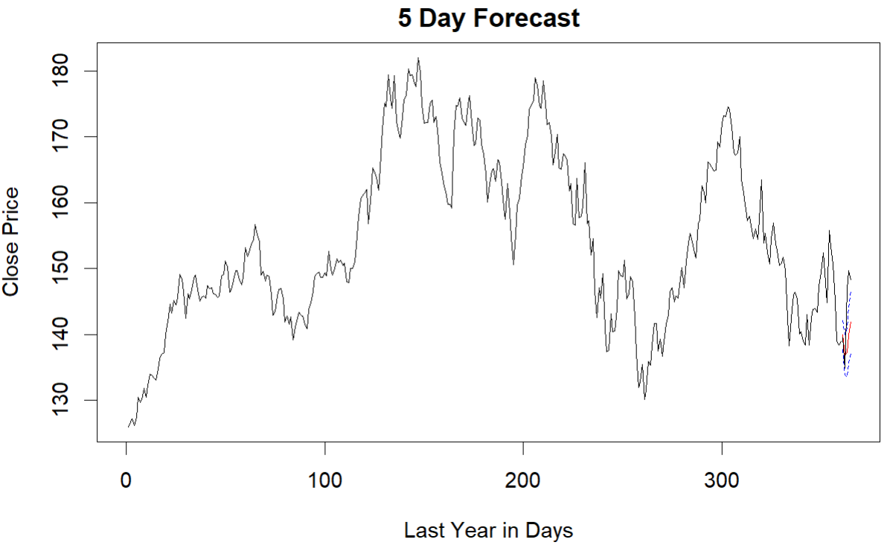
Model: var (Short term)
BIC: 27.291 at p=5
ASE: 47.076
Explanatory variables
High
Low
Open
Adj.Close
Volume
PerChange
PerSwing
Lagged all explanatory variables prior to incorporation into model
5-day forecast

Slide 9
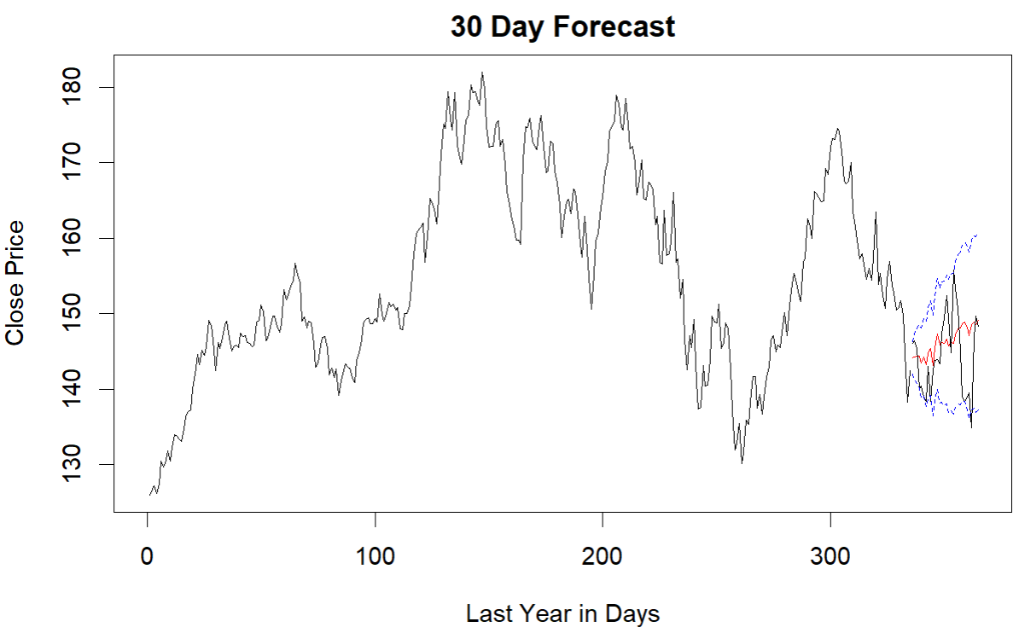
Model: var (long term)
BIC: 26.330 at p=2
ASE: 30.515
Explanatory variables
High
Low
Open
Adj.Close
Volume
PerChange
PerSwing
Explanatory variables not lagged before incorporation into model
30-day forecast

Slide 10
Model: MLP
AIC
ASE
Explanatory variables
BLAH
30-day forecast
5-day forecast

Slide 11
Model: Ensemble
AIC
ASE
Explanatory variables
BLAH
30-day forecast
5-day forecast

Slide 12
Summary
ARIMA(5,1,1)
ARMA(10,5)
VAR
MLP
Ensemble

